Slide 1
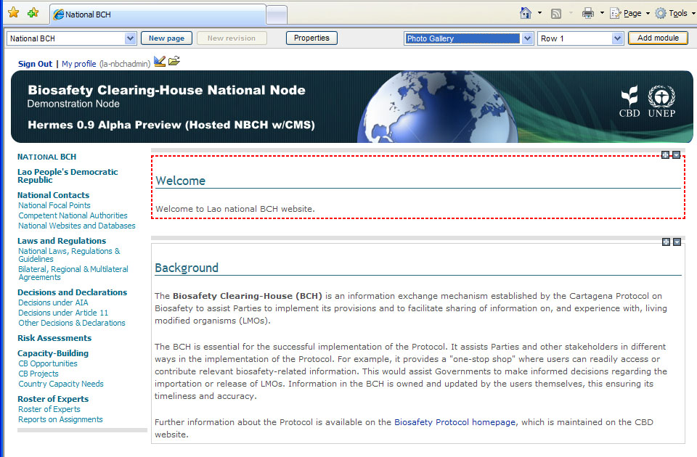

5.5 Adding Photo Gallery Module
Example. Adding Photo Gallery Module to the NBCH welcome page.
Step 1. As shown, select the following: Photo Gallery Module and Row 1. Then click Add Module.
CLICK HERE

Slide 2
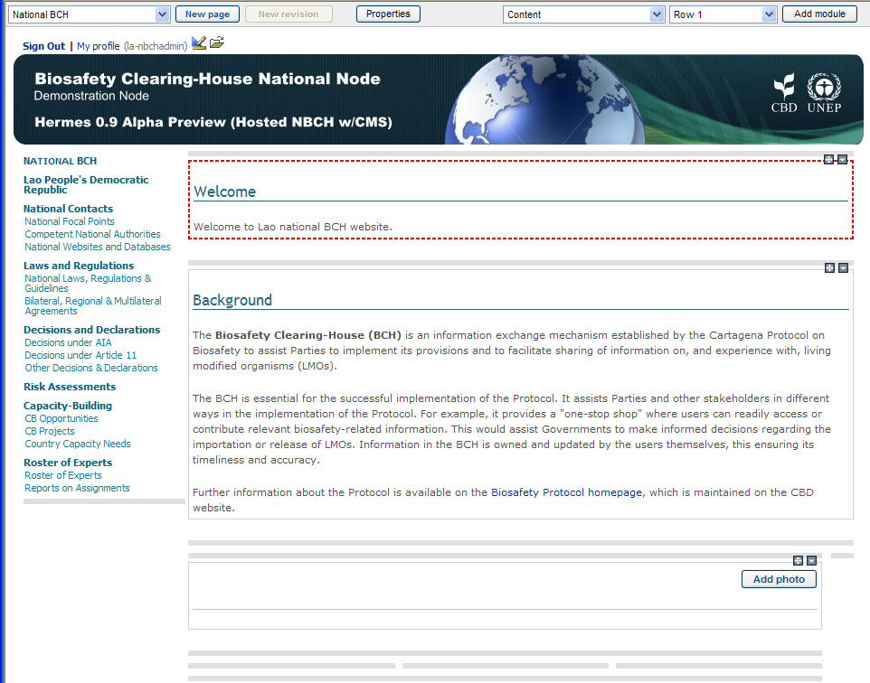
5.5 Adding Photo Gallery Module
Step 2. As shown, a new module is created. Click on the Add Photo button to enter the Photo Page.
NEWLY ADDED
PHOTO GALLERY
MODULE
CLICK HERE

Slide 3
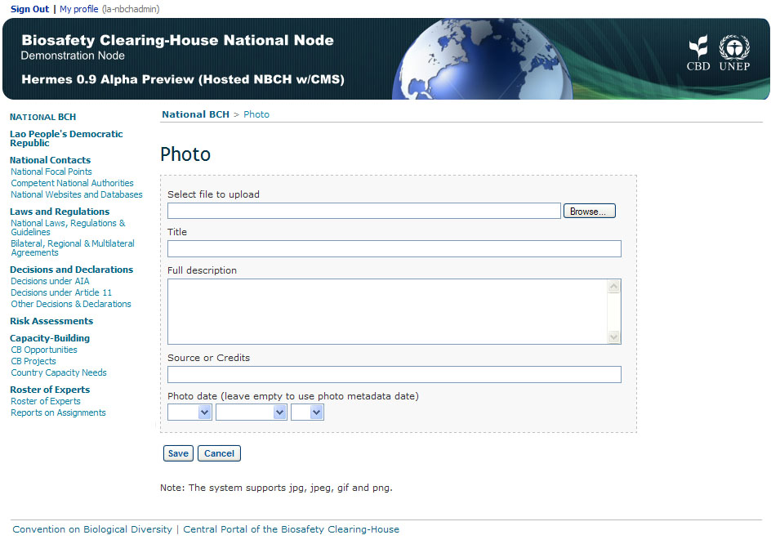
5.5 Adding Photo Gallery Module

Slide 4
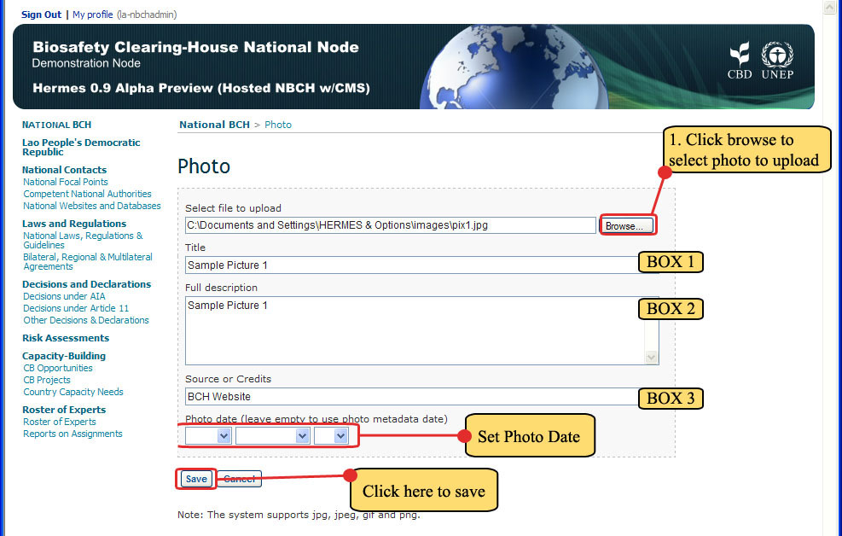
5.5 Adding Photo Gallery Module
Step 3. Inside this page, set the following as shown

Slide 5
5.5 Adding Photo Gallery Module
Select file to upload –
  First click on the BROWSE button.

Slide 6
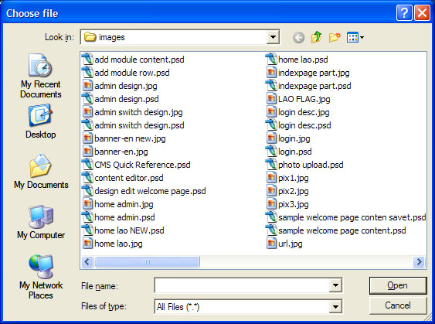
5.5 Adding Photo Gallery Module
Select file to upload –
  The choose file window will appear on screen to select the file to be uploaded.

Slide 7
5.5 Adding Photo Gallery Module
Select file to upload –
  Hermes supports the following image types: .jpg, .jpeg, .gif and .png.
  After selecting the file, click the Open button.
CLICK HERE

